Slide 1
Lab: Deploy WordPress on Minikube with Persistent Storage

Slide 2
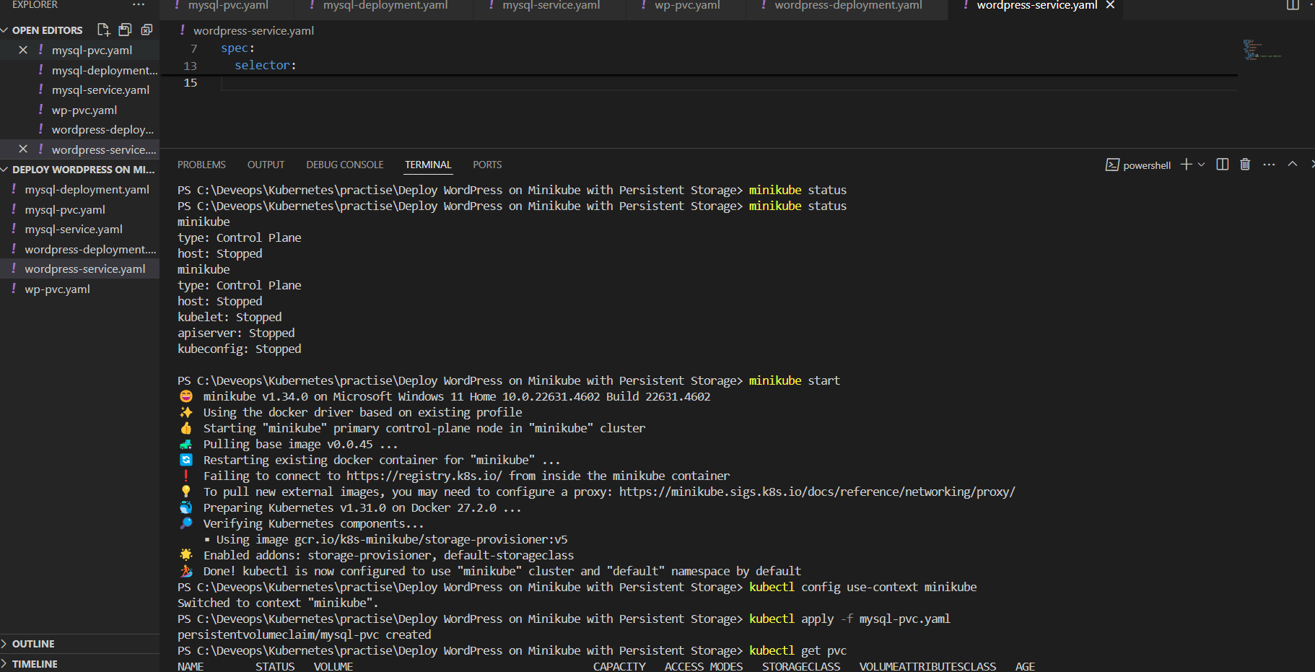

Slide 3
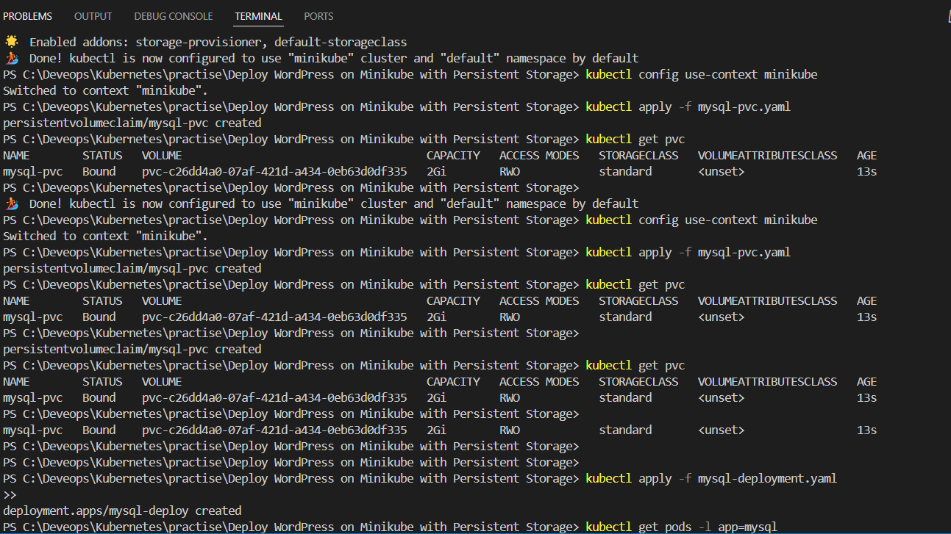

Slide 4
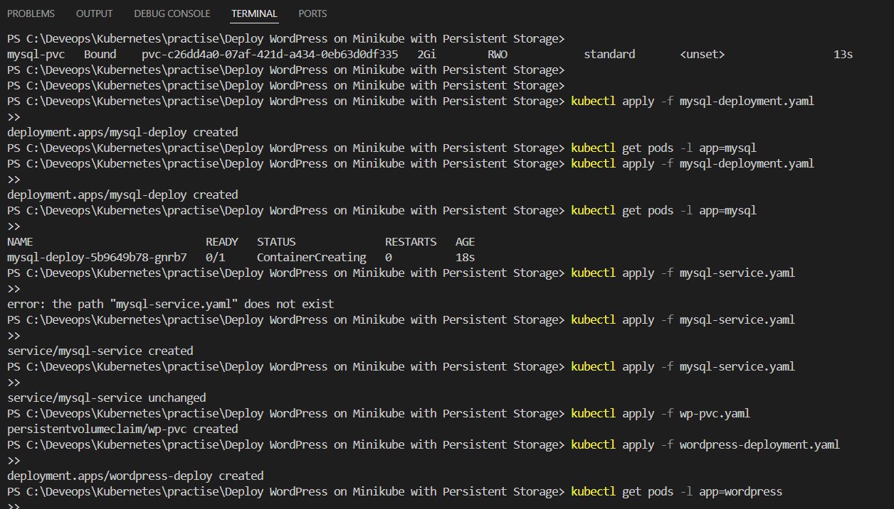

Slide 5
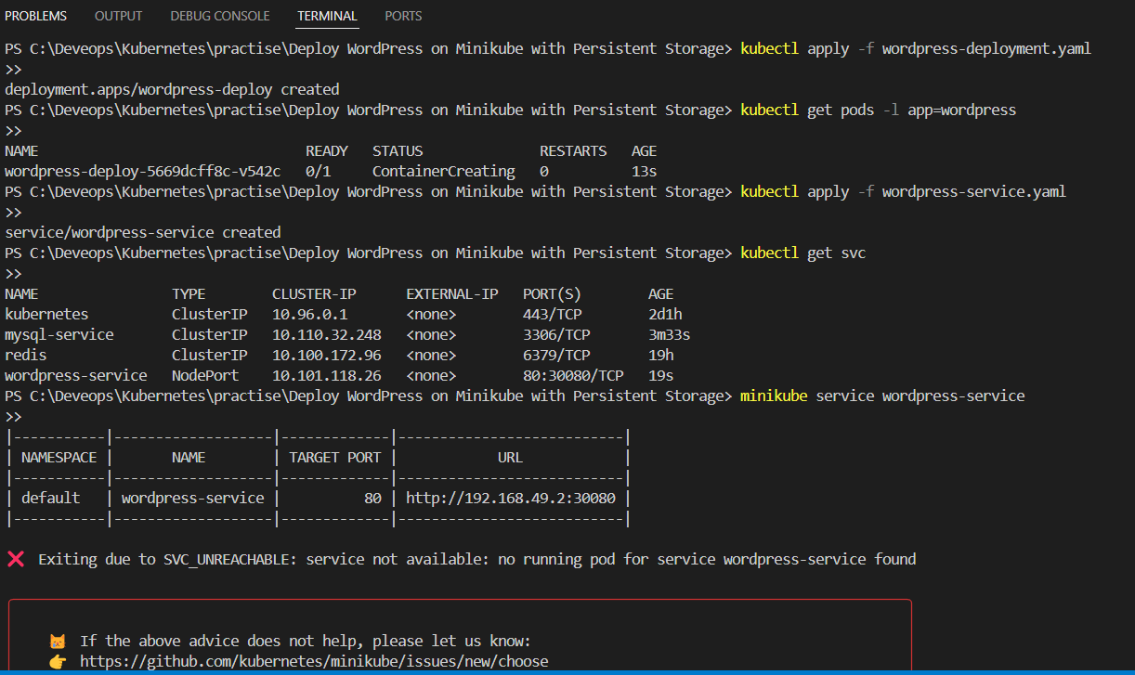

Slide 6
